Slide 1
Gesture Recognition Using a CNN
By:
Amir Modan
Darshanie Botejue

Slide 2
Introduction
The goal of the project was to detect the user’s intent based on the muscle activity in the arm
The Neural Machine Interface we will be using is based on the Convolutional Neural Network
This will be used to process the EMG signal from Myo device
It was our hope to help push forward the technology for gesture recognition
In specific to help those with physical therapy
Notes:
With Neural Machine Interfacing ever progressing, our project focused more on the gesture recognition of the convolutional neural network.
When beginning this project, we sought inspiration through the gesture recognition used to help treat in physical rehab; and the goal being to detect the user’s intent based on muscle activity in the arm.
The system will have an input of an EMG from the Myo Armband and will output which gesture is received from a list of 4 gestures.

Slide 3
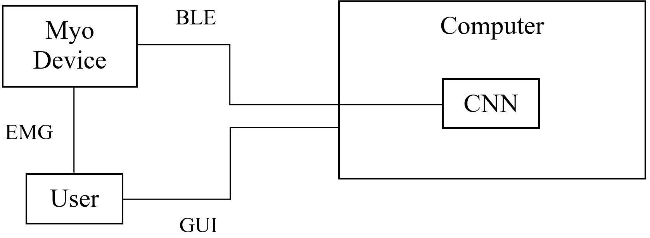
System Architecture
Notes:
The System Architecture of the project is shown with the given figure.
The Myo armband and the User interface between each other through the EMG or Electromyography which is where the data is read.
The Computer which contains the Convolutional Neural Network and uses the Bluetooth connection to interface with the Myo armband processes this data.
The User uses a GUI to interface with the computer in order to access the data and use it.

Slide 4
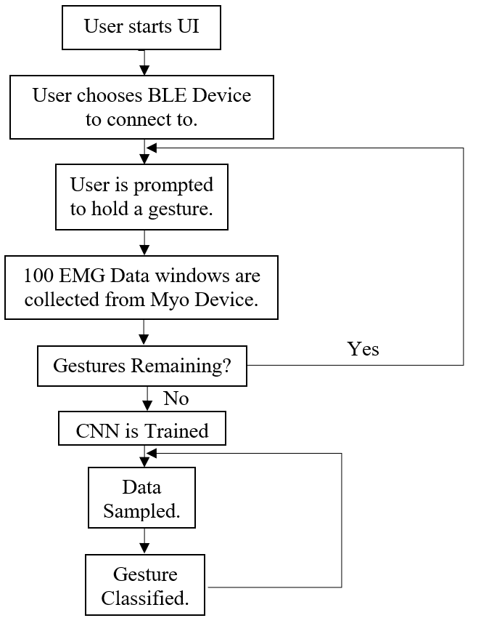
Design Flow
Notes:
In terms of the design flow, the process begins when the User starts the UI.
The User then selects a Bluetooth device to connect to and is prompted to hold a gesture.
The Myo Device will then record 100 EMG windows of data.
If the gesture remains the program will return to the prompt to hold a gesture and loop through.
When the gesture no longer remains, the CNN or the Convolutional Neural Network is trained, and the data can be sampled.
The gesture is then classified and loops through all taken data.

Slide 5
Network Architecture
Input Layer will contain 16 neurons.
I.E., 1 MAV and 1 ZC Feature for each of 8 Channels of data.
The window length will be 8 samples long.
Network will consist of one convolutional layer.
Final Layer will contain one neuron for each gesture.
Notes:
We must design our Neural Network’s Architecture such that it matches our application.
The Input Layer will contain 16 Neurons pertaining to 2 features extracted from 8 channels of data.
One convolutional layer will perform the necessary computations to classify a gesture from the features we have extracted.
There will be 5 Neurons in the last layer, each pertaining to a discrete gesture.

Slide 6
Feature Extraction & Pre-Processing
Mean Absolute Value (MAV) is calculated for 8 bytes of data by dividing the sum of all bytes by the window length.
MAV is normalized (divided) by the maximum possible MAV (127), so data ranges from 0 to 1.
Zero Crossings are obtained by counting the number of times consecutive data changes signs.
ZC is normalized (divided) by the maximum possible ZC (7), so data ranges from 0 to 1.
Features must be normalized, so that MAV and ZC carry the same amount of weight in the network.
Notes:
Because of the erratic behavior of the EMG data, we will first need to identify features in the data that our network will be able to better identify.
Our features will be Mean Absolute Value and Zero Crossings, both Time-Domain Features.
Because each feature has different ranges, each will need to be normalized so that they carry the same weight in the network.

Slide 7
Validation
Neural Network is first trained against dataset to better tune the network’s hyperparameters
Hyperparameters include # of layers, layer size, activation function, learning rate, and # of Epochs.
K-Fold Validation used with 8 folds to obtain accuracy and loss when training the dataset.
Notes:
Before designing a real-time system, we first need to verify that our network performs adequately.
Using a dataset, we will tune the network in such a way that classification will be performed in the least amount of time while yielding accurate results.
K-Fold Validation will be used as our method of evaluation.

Slide 8
Network Performance
Fold | Accuracy | Loss
1 | 97.50% | 0.0900
2 | 96.86% | 0.0868
3 | 96.30% | 0.1246
4 | 96.20% | 0.1217
5 | 97.08% | 0.0755
6 | 97.22% | 0.0937
7 | 95.58% | 0.1638
8 | 97.22% | 0.0759
Total | 96.74% | 0.1040
Notes:
A total accuracy of 96.74% was reported by taking the average of each model’s testing accuracy.

Slide 9
Network Specifications
Hyperparameter | Optimal Setting
Number of Hidden Layers | 1 Layer
Size of Hidden Layers | 8 Neurons
Activation Function | ReLU
Learning Rate | 0.01
Number of Epochs | 2
Notes:
These are the specifications of our network that were able to yield the results shown previously.
Note, we will increase the number of epochs to 10 in order to make up for the smaller batch size when moving to a real-time system.

Slide 10
Data Acquisition
Data sampled from Myo Armband at 200 Hertz.
8 Channels of data collected.
Each sample’s value ranges from 0 to 255.
Data sent in 8 Byte windows using BLE.
200 windows collected per Gesture.
Notes:
In order to port our neural network into a real-time system, we will have to take the technical specifications of the Myo Armband into account.
For instance, unsigned bytes are sent, meaning we will have to convert these into signed bytes in order to perform feature extraction correctly.
Also, the Myo armband sends data in 8 Byte windows.
For this reason, we will have our window size be of length 8 for simplicity.
A total of 200 windows will be collected for each gesture so that we have enough data to train the network while keeping the training time to a minimum.

Slide 11
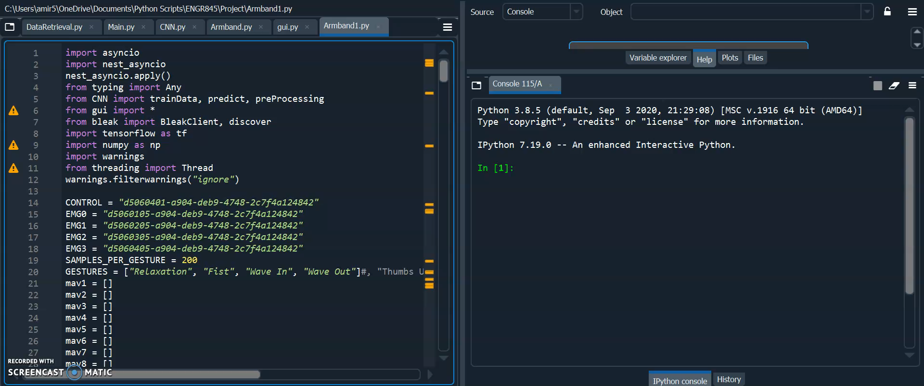
Demonstration

Slide 12
Conclusion
Convolutional Neural Networks can be used to perform gesture recognition for both a dataset or a real-time system.
Neural Network Hyperparameters can be tuned in order to achieve the desired tradeoff between accuracy and speed.
Accuracy should have priority in dataset processing.
Speed should have priority in a real-time system.
While boasting superb performance in dataset processing, neural networks may not be ideal for all real-time applications.
This is due to the vast amount of data typically needed to completely tune the weights of a neural network.
Notes:
Using a Neural Network as our classifier, we were able to perform gesture recognition both on a dataset and on a real-time system.
In order to achieve optimal performance for our specific application, we tuned the hyperparameters of the neural network to favor speed.
Though our classifier was able to perform gesture recognition with great accuracy on a pre-recorded dataset, the number of classes had to be reduced in the real-time system in order to achieve correct classification.
This is likely due to the fact that Neural Networks tend to perform at their best when provided with vast amounts of data.

Slide 13
Discussion
A Neural Network would achieve greater performance when used with a device with a high sampling rate of over 1kHz.
The Myo Armband samples at a rate of only 200Hz.
Cloud Computing can be used to speed up the training of the neural network.
This comes at the cost of communication latency.
More sensors would allow for more gestures to be classified.
Notes:
This is just a part of the Neural Network Process development; a better performance could have been achieved with a higher sampling rate such as 1kHz instead of the 200Hz from the Myo Armband.
The higher sampling rate would have helped with the accuracy and with training the gestures.
Another improvement could be through Cloud Computing to speed up the training with the seemingly infinite computations.
The downfall to Cloud Computing would be the latency in communication since there would a lag between the cloud in comparison to computing on a computer.
Finally, a great and simple way to better the system would be to include more sensors.
More sensors would allow for more gestures to be classified, as well as there would be more accuracy.
In the future it is a great hope for the project to be built upon to help with physical therapy as we had originally wished.

Slide 14
References
Myo Armband Datasheet
Myoware Muscle Sensor Datasheet
Zhang X, Zhou P: High-density myoelectric pattern recognition toward improved stroke rehabilitation. IEEE Transactions on Biomedical Engineering 2012, 59:1649-1657
Young AJ, Smith LH, Rouse EJ, Hargrove LJ: Classification of simultaneous movements using surface EMG pattern recognition. IEEE Transactions on Biomedical Engineering 2013, 60:1250-1258.
Sreenivasa M, Ayusawa K, Nakamura Y: Modeling and identification of a realistic spiking neural network and musculoskeletal model of the human arm, and an application to the stretch reflex. IEEE Transactions on Neural Systems and Rehabilitation Engineering 2016, 24:591-602.
Jiang H: Introduction of Convolutional Neural Networks (CNN). ENGR 492 Lecture Slides

